Slide 1
Mentor Me Presented by The Apptastic Four
Joe Caldwell – CVP, Field Operations
Chris Field – CVP, Customer Relationship Management
Natasha Foy – CVP, Special Projects for Agency
Tarun Gursahani – CVP, Field Learning and Development
Notes:
Welcome to Apptastic Four’s Mentor Me App
Joe, Chris, Natasha, and Tarun accepted the challenge to help make Agents lives easier by offering them a personal mentor.
We believe you have to Learn to Earn!
Research shows that mentoring can improve retention significantly (up to 72% in fact) and our conversations with experienced agents who are currently in mentoring relationships find it successful and report that it is a rewarding experience.
We’ll walk you through the app but the main idea is to give mentors and mentees a tool that’s easy to use for them to track an agents path to success and connect to a mentor for guidance along the way.
Source: Retention improvements up to 72%: https://www.linkedin.com/pulse/game-changer-how-everyone-benefits-from-workplace-mentoring-moore

Slide 2
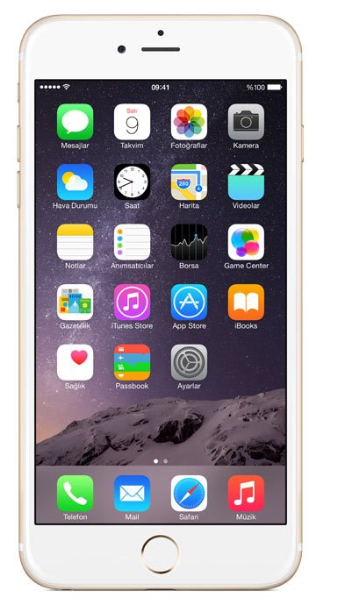
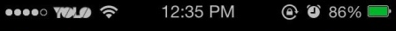

Mentor Me
Mentor Me
Notes:
So take a look at our Mentor Me app.

Slide 3

Mentor Me
Mentor Me
Notes:
[Click on Mentor Me app icon]

Slide 4









Mentor View
Hi Chris, Check out your mentees’ status:
Brady, Wayne
Second Prior
Lynch, Jane
First Prior
2
Sajak, Pat
Established
Group
Performance
+
Add a new Mentee
call
chat
email
Video chat
Notes:
The mentor logs into the app and their home screen lists all their mentees, has a link to a group view and offers the ability to add a new mentee.
The group view adds a gamification component to the app. It will summarize all the mentees results on one screen. At any time the mentor can share the group results with the team of mentees to encourage competition.
Mentors will see alerts on performance when an agent goes below their pro-rated goal.

Slide 5
Mentor View
Hi Chris, Check out your mentees’ status:
Brady, Wayne
Second Prior
Lynch, Jane
First Prior
2
Sajak, Pat
Established
Group
Performance
+
Add a new Mentee
call
chat
email
Video chat
Notes:
[Click on Pat Sajak]

Slide 6

Mentor View
Hi Chris, Pat Sajak’s progress:
Activity
Name Flow
75% of goal
Calls
45% of goal
1
Total Appointments
37% of goal
1
Pat: I could use those for a new client.
Chris: I have some illustration samples.
Pat: Thanks for explaining them so clearly.
Chris: Glad we had a chance to meet the other day to discuss term conversions.
call
chat
email
Video chat
Notes:
Mentors can offer guidance on specific activities by using the comment buttons next to each individual activity.
Here we see the mentor/mentee’s prior conversation.

Slide 7
Mentor View
Hi Chris, Pat Sajak’s progress:
Activity
Name Flow
75% of goal
Calls
45% of goal
1
Total Appointments
37% of goal
1
Pat: I could use those for a new client.
Chris: I have some illustration samples.
Pat: Thanks for explaining them so clearly.
Chris: Glad we had a chance to meet the other day to discuss term conversions.
call
chat
email
Video chat
Notes:
[Click on Comment Button]
When the mentor clicks on the comment button, they can add a new message

Slide 8
Mentor View
Hi Chris, Pat Sajak’s progress:
Activity
Name Flow
75% of goal
Calls
45% of goal
Total Appointments
37% of goal
1
Pat: Thanks!
Chris: Link to phone scripts on Portal.
Pat: Having trouble starting conversations
Chris: Name flow looks good, but do you need help with calls?
call
chat
email
Video chat
Notes:
We believe this is a key differentiator: mentors will receive an early indicator, be able to intervene immediately with targeted best practices and support, and keep the agent motivated to succeed.
On each screen mentors have the option to call, text, email or video chat with their mentees and the mentees can do the same.

Slide 9
Mentee Views
Notes:
Intro Mentee Views

Slide 10
Activity
Hi Pat, Check out your progress:
Activity
Name Flow
75% of goal
Calls
45% of goal
Total Appointments
37% of goal
Pat: Thanks!
Chris: Link to phone scripts on Portal.
Pat: Having trouble starting conversations
Chris: Name flow looks good, but do you need help with calls?
call
chat
email
Video chat
Notes:
When a mentee agent logs into the app they are taken to their Activity Screen. They have clear goals for each activity and the app tracks their progress on a daily basis.
Agents are motivated throughout the week by their own progress (marked by icons of success – smiley faces and check marks).
A smiley face icon appears if they are on track to hit the goal and it changes to a check mark when they achieve 100% of that goal. Text below each goal lets them know how they are doing on a percentage basis toward the goal.

Slide 11
Activity
Hi Pat, Check out your progress:
Activity
Name Flow
75% of goal
Calls
45% of goal
Total Appointments
37% of goal
Pat: Thanks!
Chris: Link to phone scripts on Portal.
Pat: Having trouble starting conversations
Chris: Name flow looks good, but do you need help with calls?
call
chat
email
Video chat
Notes:
Some metrics can be expanded to reveal additional detailed data

Slide 12
Activity
Hi Pat, Check out your progress:
Activity
Total Appointments
37% of goal
Open
Closing
Delivery
20% of goal
45% of goal
65% of goal
Fact Finders
25% of goal
Pat: Thanks!
Chris: Link to phone scripts on Portal.
Pat: Having trouble starting conversations
Chris: Name flow looks good, but do you need help with calls?
call
chat
email
Video chat
Notes:
The activities listed here have been identified as the keys to success from conversations with agents but they can be adjusted as needed and others can be added such as training and social media metrics. Additionally, as analysis is developed we may learn that other metrics become important.
The most recent communications that the mentor and mentee have had will appear in the communications section of the activity screen.
On each screen mentees have the same call, text, email or video chat options that the mentor had.

Slide 13
Activity
Hi Pat, Check out your progress:
Activity
Total Appointments
37% of goal
Open
Closing
Delivery
20% of goal
45% of goal
65% of goal
Fact Finders
25% of goal
Pat: Thanks!
Chris: Link to phone scripts on Portal.
Pat: Having trouble starting conversations
Chris: Name flow looks good, but do you need help with calls?
call
chat
email
Video chat
Notes:
Agents can then see their productivity by swiping to the next screen

Slide 14
Productivity
Hi Pat, Check out your progress:
Productivity
Pro Rata FYC
50% towards YTD goal
Expense Allowance 6%
25% on track to next milestone
Council Tracker
QC
40% on track to next level
Product Mix
call
chat
email
Video chat
Notes:
Here agents can see the benefits of all their hard work.
Are they are pro-rata through the current month YTD?
Have they qualified for expense allowance? If so the level they have qualified for will appear above the bar and the progress will be tracking to the next level.
Similarly for the council tracker, the bar will reflect the amount needed to qualify for QC or, if they have already qualified for QC how close are they to getting to EC, and so on
And finally a snapshot of the agents Product Mix

Slide 15
Productivity
Hi Pat, Check out your progress:
Productivity
Pro Rata FYC
50% towards YTD goal
Expense Allowance 6%
25% on track to next milestone
Council Tracker
QC
40% on track to next level
Product Mix
call
chat
email
Video chat
Notes:
Agents can also get to the full chat history by swiping from the productivity page.

Slide 16

Chat History
Hi Pat, Check out your progress:
Pat: Thanks!
Chris: Link to phone scripts on Portal.
Pat: Having trouble starting conversations
Chris: Name flow looks good, but do you need help with calls?
Pat: I could use those for a new client.
Chris: I have some illustration samples.
Pat: Thanks for explaining them so clearly.
Chris: Glad we had a chance to meet the other day to discuss term conversions.
Pat: I didn’t know these were available. They are super helpful and Rick Paulsen is great … “Top of the Day!”
Chris: Have you checked out the videos on NYL View? Take a look and lets discuss.
call
chat
email
Video chat
Notes:
Here agents can review their full chat history with their Mentor, refresh their memory on previous tips and refer back to previous attachments and videos.
This screen can also be reached from the communication boxes on any of the prior screens.

Slide 17
Chat History
Hi Pat, Check out your progress:
Pat: Thanks!
Chris: Link to phone scripts on Portal.
Pat: Having trouble starting conversations
Chris: Name flow looks good, but do you need help with calls?
Pat: I could use those for a new client.
Chris: I have some illustration samples.
Pat: Thanks for explaining them so clearly.
Chris: Glad we had a chance to meet the other day to discuss term conversions.
Pat: I didn’t know these were available. They are super helpful and Rick Paulsen is great … “Top of the Day!”
Chris: Have you checked out the videos on NYL View? Take a look and lets discuss.
call
chat
email
Video chat
Notes:
[Let’s take it “Home”]

Slide 18
Other Considerations
Tangential benefits for orphaned Agents
Managing Partner, Partner & Sales Development Manager views
Adding more ambitious “stretch” goals once a company standard is achieved
Self mentoring metrics that are automatically fed to app based on activity
Historical reporting and additional data analysis
Notes:
[Read slide]

Slide 19
Q&A
Notes:
Intro Mentee Views

Slide 20
Notes:
Collect prize!

